Slide 1
HTML and CSS
A brief introduction

Slide 2
Agenda
HTML
CSS
JavaScript

Slide 3
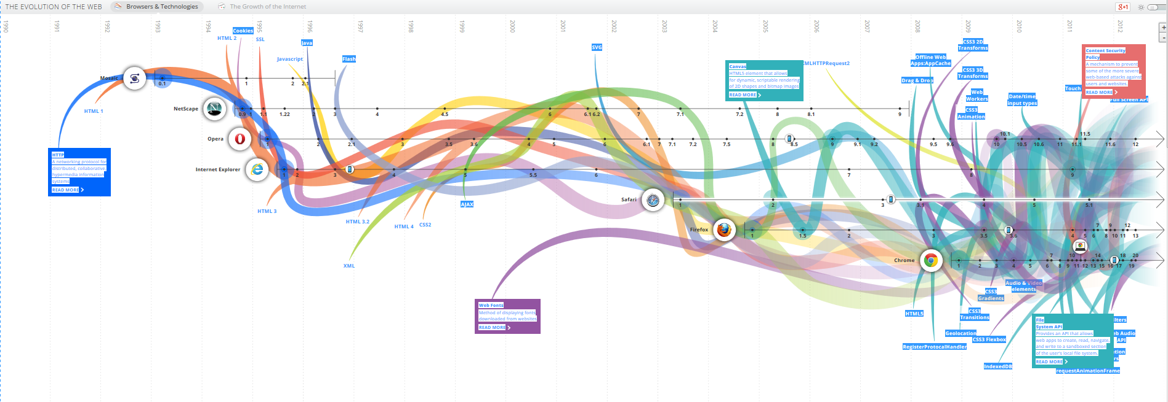
Evolution of Web Technology
Source: http://www.evolutionoftheweb.com (Google Chrome team)

Slide 4
Building Blocks of Web Development
Essential technologies of web based application design:
HTML — Structure and semantics of an application
CSS — Look, feel and formatting of an application
Javascript — Dynamic functionality and features
Analogy of building a house:
HTML — the foundation and fixed structure of a house, floor, windows, doors…
CSS — decorations of a house, carpets, window frames and drapes…
Javascript — electrical wiring, plumbing, and appliances…
Notes:
JS:
Validate forms, detect browsers, dynamically change the web content and, connect front-end to backend service and data source, to name a few.
Analog is that to build a house
HTML will be the foundation and structure, add wall, floor, windows, doors, and stairs
CSS will be the carpet, wallpaper, door frame, and etc.
JavaScript will be the electrical wiring, telephone, and cable wires, and appliance such as TV, reregister, to provide dynamic features.

Slide 5
HTML—HyperText Markup Language
HTML is a standard markup language for creating web pages
Web browsers read HTML files and render them into web pages
HTML describes the structure of a website semantically, making it a markup language, rather than a programming language (such as Java/C#)
Tags are the basic building block in HTML Each HTML tag describes different content within the same document
<html> … </html>
Notes:
HTML is the foundation and structure of a house, CSS is the wall paper, carpet, and other declarative items that make the house beautiful, or as we say in application design user-friendly.
HTML → structure,
CSS → look and feel,
Together, they are responsible for the UE, user experience.

Slide 6
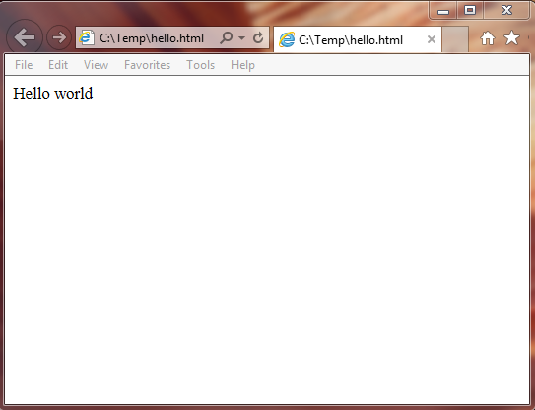
HTML Introduction
HyperText Markup Language
Angle bracket (tag) based structure
Defines structure of a web page
<html>
<head>
</head>
<body>
Hello world
</body>
</html>
Notes:
Hello.html
<head> meta data info about the page
<body> the content of the page

Slide 7
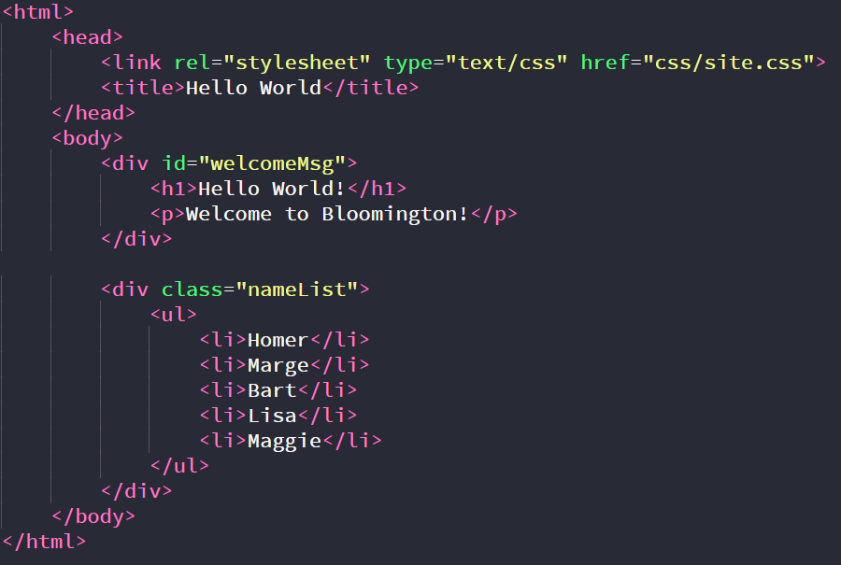
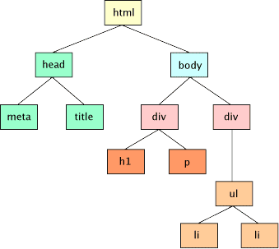
DOM in HTML
Notes:
The <!DOCTYPE html> declaration defines this document to be HTML5
The text between <html> and </html> describes an HTML document
The text between <head> and </head> provides information about the document
The text between <title> and </title> provides a title for the document
The text between <body> and </body> describes the visible page content
The text between <h1> and </h1> describes a heading
The text between <p> and </p> describes a paragraph

Slide 8
Hands-on Practice: index.html
Change title of the page
Add a <div> tag with id="welcomeMsg" Inside the div
Add a header tag <h1> … </h1>
Add a paragraph tag <p> … </p>
Add two <div> tags with class="special"
Add a paragraph tag <p> … </p>

Slide 9
Styling in HTML
CSS is a style sheet language used for describing the look and formatting of HTML documents
Inline Styles — Style Property
Not best practice, we should separate UI (DOM structure) and Style
Internal Style — Style Tags
Not best practice, it is only separate UI and Style on a “per page” basis
External Style Sheet — Cascading Style Sheets
Contain rules for styling the UI in a separate file (.css)
Leave HTML structural information in a stand-alone file (.html)
Best Practice since it allows site-wide rules and overriding for specific cases/pages
Notes:
Inline Styles - Style Property
Every element(tag) in HTML has style property which contains rules for formatting
Not best practice since we should separate UI (DOM structure) and Style
Internal Style - Style Tags
Every HTML page can have style tags that contain styling information separate from HTML
Not best practice since it is only separate UI and Style on a “per page” basis

Slide 10
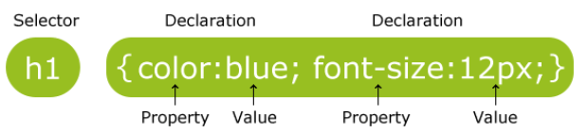
CSS Syntax
A CSS rule set consists of a selector and a declaration block
The selector points to the HTML element you want to style.
The declaration block contains one or more declarations separated by semicolons.
Each declaration includes a property name and a value (name-value pair), separated by a colon, and must end with a semicolon.
h1 {
color: blue;
font-size: 12px;
}

Slide 11
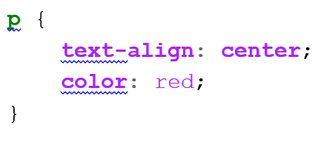
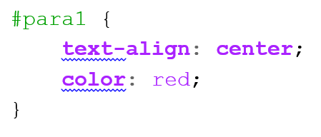
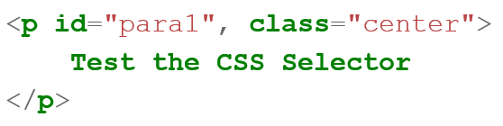
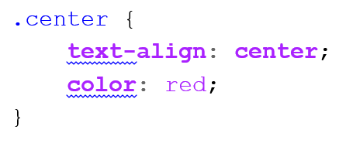
CSS Selector
element Selector: selects all elements based on the type.
id Selector: select a specific element based on the id attribute of an HTML element
class Selector: selects all elements based on the class attribute.
element
id
element
id
class
class

Slide 12
CSS Rules
Inheritance Rule:
Children elements will inherit the styles from parent element
Overriding Rule:
Children element can override styles inherited from parent
For the same element, later styles will override/mask earlier styles definition for the same property
Cascading Rule:
Rules of more specific elements will override the less specific rules

Slide 13
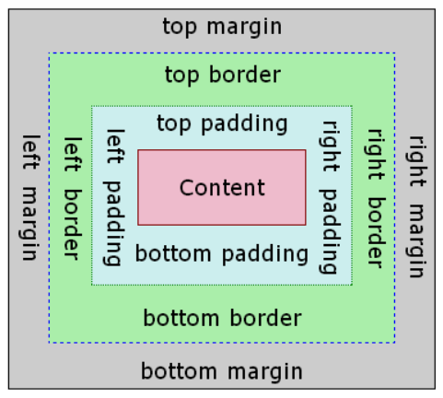
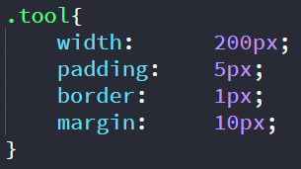
Size in CSS - The Box Model
Content
Padding
Border
Margin
200px
5px
1px
10px
Actual Width = 200 + 2*5 + 2*1 + 2*10 = 232px
Source: www.codeproject.com

Slide 14
Hands-on Practice: site.css
Add a css folder, and create a new file called site.css
Add link to css/site.css in index.html
In the site.css
Change font family of all contents in index.html
Change h1 to display a different color and font size
Add padding to div by id
Add margin, boarder, and padding to form by class

Slide 15
Appendix

Slide 16
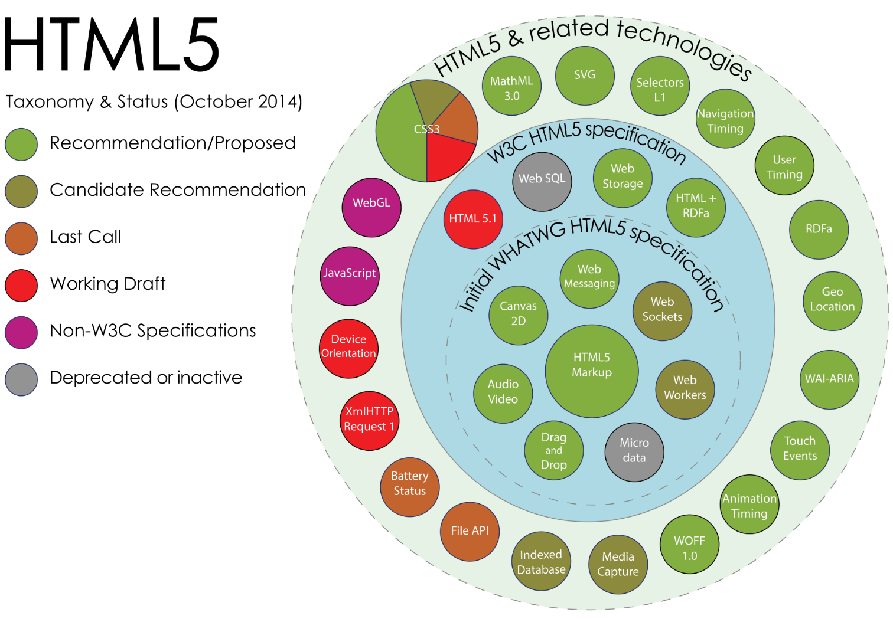
HTML 5 Ecosystem
Sergey Mavrody, 2014, CC BY-SA 4.0

Slide 17
CSS Current Trend
WikiMedia, 2017 Adapted from Sergey Mavrody, 2014, CC BY-SA 4.0
Notes:
CSS3 is the latest standard for CSS.
CSS3 is completely backwards-compatible with earlier versions of CSS.

